Slide 1


Disaster Tweets - Sentiment Analysis
Predicting disaster-related tweets using Natural Language Processing (NLP) techniques
by Pankaj Devikar

Slide 2
Problem Statement
Goal
Categories
Classify disaster tweets accurately
Actual Disaster vs. Metaphorical Disaster

Slide 3

Project Overview
Techniques
Models
Natural Language Processing (NLP)
Machine Learning & Deep Learning

Slide 4
Dataset Overview
Source
Features
Twitter disaster tweets
id, text, location, keyword, target

Slide 5
Data Cleaning & Preprocessing
Text Cleaning
Tokenization & Vectorization
Removing URLs, HTML, emojis, stopwords
TF-IDF Vectorizer for text transformation

Slide 6
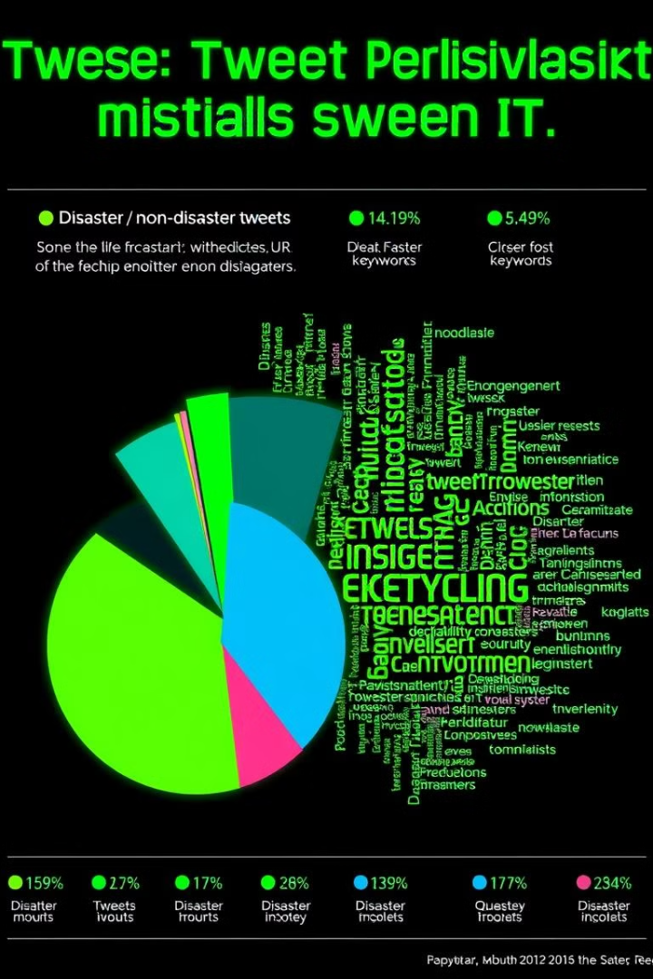
Exploratory Data Analysis (EDA)
Label Distribution
Word Cloud
Frequent words in the dataset
Disaster vs. non-disaster tweets

Slide 7
Machine Learning Models
Model
Accuracy
Precision
Recall
F1 Score
Time
Logistic Regression
85%
83%
87%
85%
0.1s
Naive Bayes
87%
86%
89%
88%
0.05s
SVM
84%
82%
86%
84%
0.5s
Random Forest
86%
85%
88%
87%
0.2s

Slide 8




Deep Learning Models
1
Single Layer Perceptron
Multi-Layer Perceptron
2
SIGMOID, RELU
Optimization Techniques
3
ADAM vs. SGD
Regularization
4
Dropout, Batch Normalization

Slide 9
Model | Weighted Precision | Weighted Recall | Weighted F1-Score | CPU Time (Total) | Wall Time
Single Layer Perceptron | 0.0303 | 0.1741 | 0.0517 | 52.5 s | 38.5 s
SIGMOID + ADAM | 0.0303 | 0.1741 | 0.0517 | 35 min 22 s | 13 min 39 s
SIGMOID + SGD | 0.0303 | 0.1741 | 0.0517 | 16 min 21 s | 7 min 11 s
RELU + ADAM | 0.8839 | 0.8896 | 0.8856 | 37 min 5 s | 13 min 38 s
RELU + SGD | 0.0303 | 0.1741 | 0.0517 | 18 min 12 s | 7 min
SIGMOID + BN + ADAM | 0.0303 | 0.1741 | 0.0517 | 38 min 34 s | 14 min 27 s
SIGMOID + BN + SGD | 0.0303 | 0.1741 | 0.0517 | 19 min 43 s | 7 min 47 s
RELU + DROPOUT + ADAM | 0.8836 | 0.8892 | 0.8854 | 30 min 58 s | 14 min 25 s
RELU + DROPOUT + SGD | 0.8368 | 0.8307 | 0.7600 | 16 min 40 s | 7 min 13 s

Slide 10
Model Evaluation & Results
Best Model
Metrics
Naive Bayes (ML), RELU + ADAM (DL)
Accuracy, Precision, Recall, F1 Score, Time

Slide 11

Conclusion
Key Insight
Final Thought
Deep Learning can overfit/underfit
RELU + ADAM with Dropout for best performance

